Slide 1
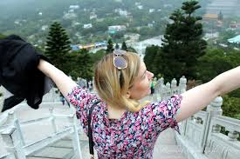
VALIT - Value Indicator Tool Research Project

Slide 2
Research consortium
Four research partners:
Tampere University of Applied Sciences
University of Vaasa
Tampere University of Technology
VTT Research Centre
Multidisciplinary research: marketing, ict, human resources, sociology
Nine companies (IT companies, consulting companies, insurance company, industrial companies)
Duration 3 years (1.1.2015-31.12.2017)
Budget 1 050 000 e

Slide 3
Background
DIGITALIZATION
VALUE CREATION
EXPERTISE
INDIVIDUAL
GLOBALIZATION
CUSTOMER
EXPERIENCE

Slide 4
Research questions
What is the role of emotions and feelings in b2b relationships?
How to manage feelings and customer experience?
How to measure created value?
How to develop and manage customer relationships based on value creation?
How to manage manage value creation in business networks?
How to support employees to create value and how to develop personnels value creation competences?

Slide 5
Main research angels to value co-creation in the project
Participatory personnel development
Emotional experiences
Perceived customer value
Value
co-creation
Development of business relationship management

Slide 6
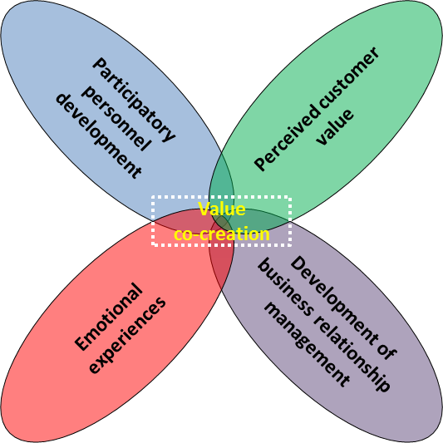
”Research package” of TAMK
Value for business from emotional experiences in b-to-b -sector
The aim of the RP/TAMK is to study and develop new business models in value co-creation which take in depth into account the customer’s emotional experiences, i.e. emotional path, in the b-to-b –sector.
This calls for understanding the immaterial value creation* mechanisms and emotional experiences in various technological, social, IT-related, cultural and commercial circumstance s and applications.
Identifying and analyzing emotional paths and their relationship to value creation.
Models to better manage customer experience.
____________________________
* Immaterial value creation refers broadly to solutions based on knowledge and expertise, as well as on
(emotional) experiences.

Slide 7
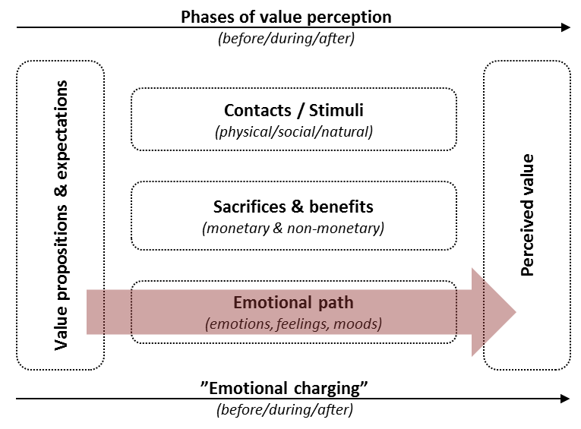
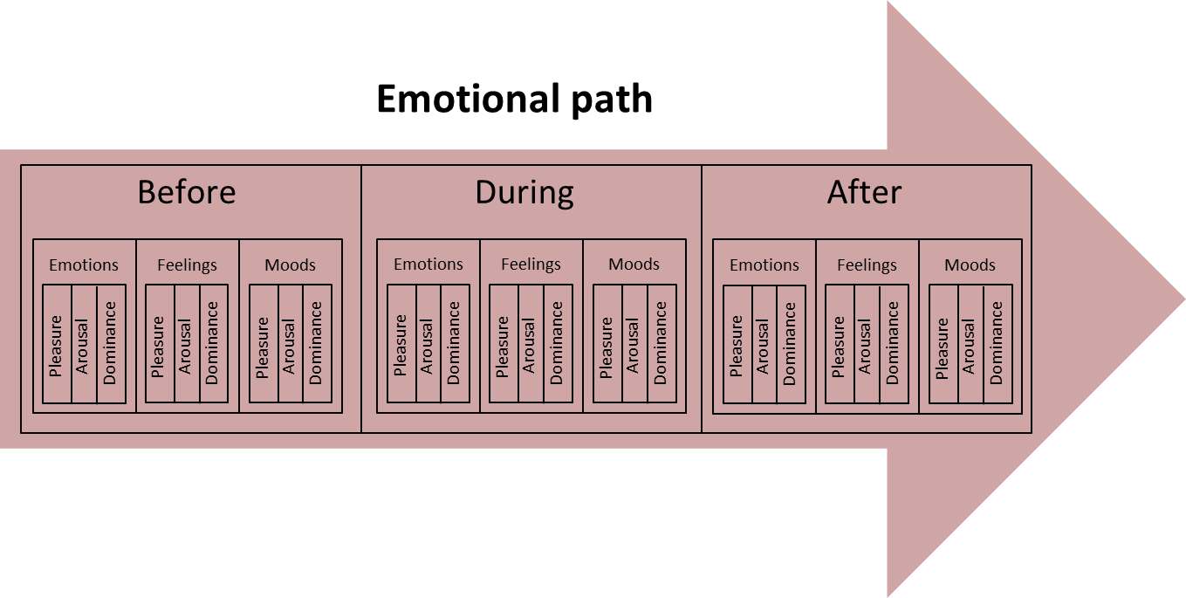
Tentative theoretical framework (1)
In the phases of the value perception process the customer has various contacts and is exposed to various stimuli.
In the phases the customer travels through an emotional path.
Before the transaction and in addition to the value expectations the customer has an pre-existing emotional state.
During the transaction the customer gets emotional experiences.
After the transaction the customer is left with an emotional state.
Emotional experiences vary along e.g. with their somatic intensity, duration, direction and controllability (cf. emotions, feelings and moods).
Emotional experiences can be described and measured with three main dimensions: pleasure, arousal and dominance.
In addition to the sacrifices and benefits the emotional states and experiences in the emotional path have an effect on the customer perceived value.
The value perception process is therefore “emotionally charged”.

Slide 8
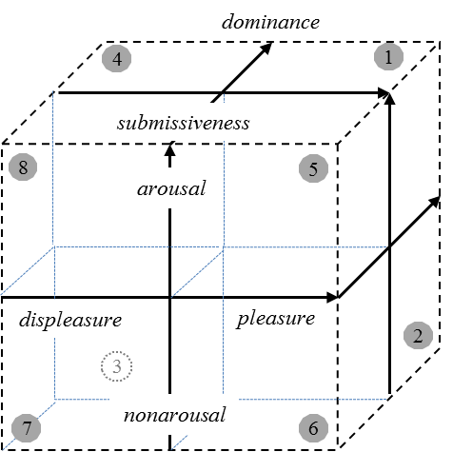
Tentative theoretical framework (2)
Variations in pleasure, arousal and dominance should universally constitute the common core of human emotional experiences.
In a general level, pleasure refers to the degree to which an individual feels good, happy, or satisfied. Similarly, arousal refers to the degree to which an individual feels excited, stimulated, alert, or active. Dominance, in turn, refers to the degree to which an individual feels in control of, or free to act.
According to these three sets, a three-dimensional space can be formed to capture the core: pleasure-displeasure, arousal-nonarousal, and dominance-submissiveness.
1: P+A+ Elation D+ Excitement in a sense of pleasant excitement under one’s own control
5: P+A+ D- Suspense in a sense of pleasant excitement beyond one’s own control
2: P+A- Serenity D+ Contentment in a sense of relaxation on one’s own terms
6: P+A- D- Drowsiness in a sense of pleasant sleepiness without one’s own control
3: P-A- Lethargy D+ Laziness in a sense of indolence (reluctance to take action)
7: P-A- D- Dejection in a sense of total gloominess
4: P-A+ Tension D+ Stress in a sense of unpleasant responsibility
8: P-A+ D- Irritation in a sense of anger beyond one’s control

Slide 9
International co-operation
Theses of different level (Bachelor-, Master-, Doctoral-) and other projects
Shared data
Comparative data (and analysis)
Joint publications and other materials
Conference papers
Journal articles
Popular articles
Teaching materials
Seminars and workshops
Researchers / teachers
Students
Business life representatives
Potential spin-offs

