Slide 1


PROBLEMATIC CANNABIS USE
AMONG A SAMPLE OF FINNISH YOUTH
Jasmin Lostedt, Minna Stolt, Solja Niemelä, Miko Pasanen, & Kaisa Mishina University of Turku, 4th of November 2023

Slide 2
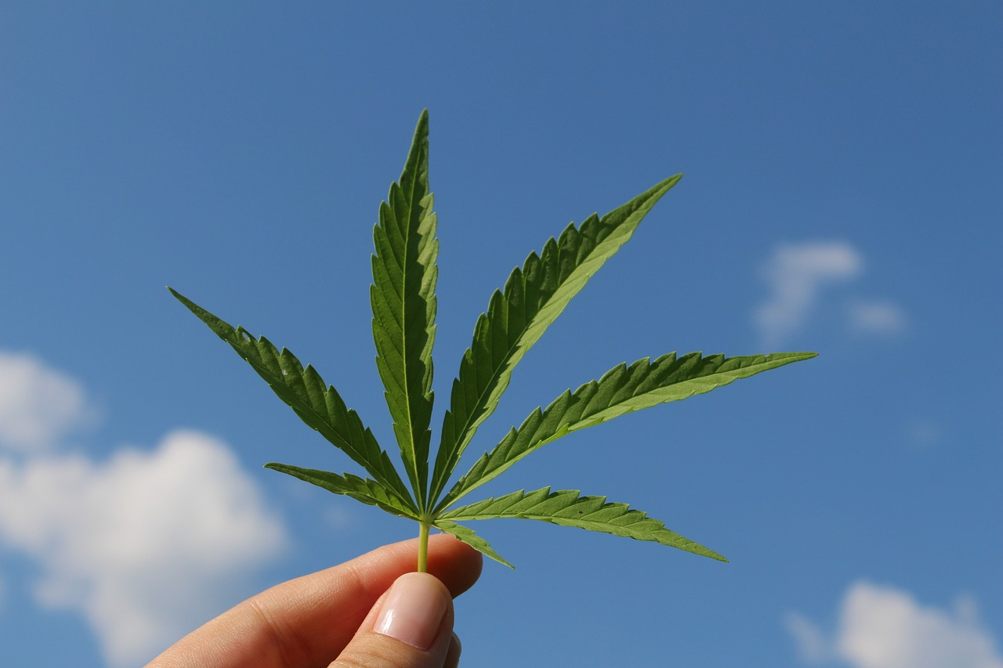







Slide 3

BACKGROUND

Slide 4


BACKGROUND
The majority of cannabis use is experimental, but more frequent cannabis use increases the risk for problematic cannabis use (Mustonen et al. 2019). However, measuring only the frequency of cannabis use does not provide enough information on the risk levels for problematic cannabis use. (Asbridge et al. 2014). This study aims to assess the risk levels for problematic cannabis use among Finnish youth

Slide 5

METHODS

Slide 6

METHODS
A cross-sectional survey was conducted with vocational students in eight Finnish vocation schools from 2020-2021. The inclusion criteria used was: a) 17-29 years old, b) able to provide informed consent, and c) fluent in Finnish. Information on age and gender was collected. Cannabis Abuse Screening Test (Legleye et al. 2007) were used to examine the risk levels for problematic cannabis use. Descriptive statistics were calculated for describing the sample and risk levels for problematic cannabis use

Slide 7

RESULTS

Slide 8
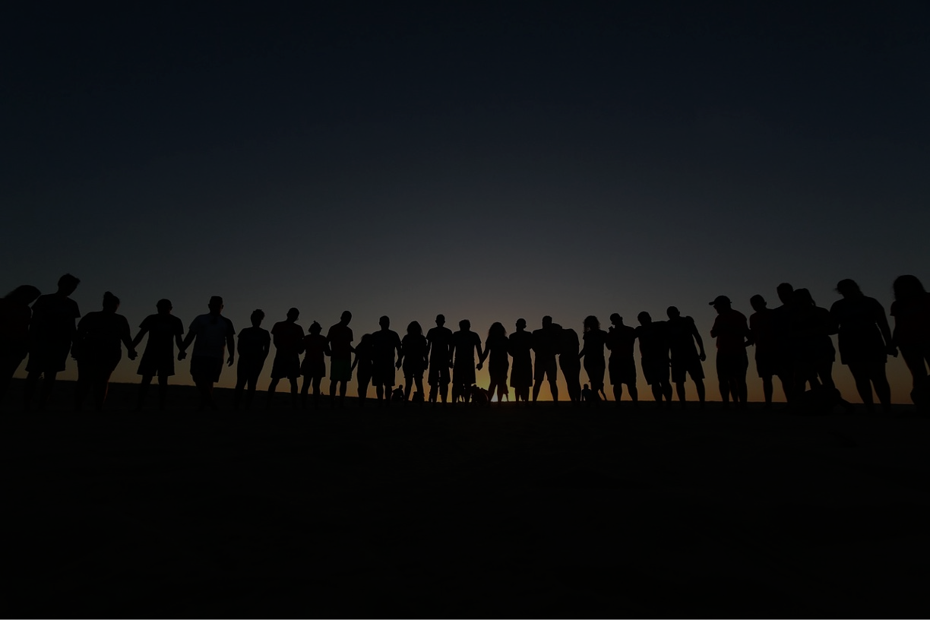
RESULTS
From the participants (n=1,855), the majority were aged 18 or older (69.9%) and identified as female (52.3%). 589 (31.8%) youth had used cannabis in the past year. The risk levels for problematic use were evenly distributed between low (0-2 points,12.29%), moderate (3-6 points, 8.52%), and severe (7-24 points, 10.89%) levels.

Slide 9

DISCUSSION

Slide 10

DISCUSSION
The findings of this study shows that the perceived problematic nature of cannabis use varies. Some of those who used cannabis during the year had a low risk for problematic use, which may indicate irregular and/or experimental use. Some, on the other hand, had a moderate or severe risk for problematic use, which in turn may indicate more regular use, the formation of a pattern of use, and/or increased perceived problems. This study has its strengths and weaknesses: study design, data collection method, self-report data, CAST instrument,
Notes:
The findings of this study shows that the perceived problematic nature of cannabis use varies. Some of those who used cannabis during the year had a low risk of problematic use, which may indicate irregular and experimental use. Some, on the other hand, had a moderate or severe risk of problematic use, which in turn may indicate more regular use, the formation of a pattern of use and/or increased perceived problems. Strenghts and weaknesses: The study design and data collection method supported the research aim posed for the study. However, we used self-report data, which can have contributed to a low response rate. The data may also have been self-selecting, due to the voluntary nature of the participation. The study did not necessarily reach all those who use cannabis problematically and may contribute to underestimating the prevalence of problematic cannabis use. We tried to solve these issues in advance by choosing a purposive sampling method, reaching out to schools where cannabis use is known to be relatively high. Using this sampling method, we obtained to reflect the average population of vocational schools in Finland, as regards age and gender. This study can have bias for over and under estimation, due the social desirability of the answers. However, it is known that adolescents and young adults responses to their substance use are valid and reliable (Winters et al. 1990). We used screening instrument to detect problematic cannabis use and not only frequency. However, CAST is not validated in Finland, but in multiple countries includien European countries

Slide 11

CONCLUSIONS

Slide 12

CONCLUSIONS
Evenly distributed risk levels of problematic cannabis use show the variability of problematic use among young people. This, in turn, poses challenges for professionals dealing with young people who use cannabis. Screening instruments that identify risk levels of problematic cannabis use and forms of support and treatment tailored to risk levels are needed so that problems caused by the use of cannabis can be prevented.
Notes:
Evenly distributed risk levels of problematic cannabis use show the variability of problematic use among young people. This, in turn, poses challenges for professionals dealing with young people who use cannabis. Screening instruments that identify risk levels of problematic cannabis use and forms of support and treatment tailored to risk levels are needed so that problems caused by the use of cannabis can be prevented.

Slide 13

REFERENCES

Slide 14

REFERENCES
Asbridge, M., Duff, C., Marsh, D. C., & Erickson, P. G. (2014). Problems with the identification of ‘problematic' cannabis use: Examining the issues of frequency, quantity, and drug use environment. European Addiction Research, 20(5), 254-267.
Legleye, S., Karila, L., Beck, F., & Reynaud, M. (2007). Validation of the CAST, a general population Cannabis Abuse Screening Test. Journal of substance use, 12(4), 233-242.
Mustonen, A., Hielscher, E., Miettunen, J., Denissoff, A., Alakokkare, A. E., Scott, J. G., & Niemelä, S. (2021). Adolescent cannabis use, depression and anxiety disorders in the Northern Finland Birth Cohort 1986. BJPsych Open, 7(4). Winters, K. C., Stinchfield, R. D., Henly, G. A., & Schwartz, R. H. (1990). Validity of adolescent self-report of alcohol and other drug involvement. International Journal of the Addictions, 25(11), 1379-1395.

