Slide 1
ONE GLASS-CEILING to SHATTER: The CASE OF RADICAL CONSUMPTION POLICY-CHOICES BY FINNISH REGIME REPRESENTATIVES Presentation at the ECPR 2017 Joint Sessions “Beyond the Environmental state?”
Sanna Ahvenharju, FFRC

Slide 2
Finland Futures Research Centre (FFRC) produces and develops visionary knowledge regarding alternative futures and the challenges and possibilities included in them. Founded in 1992, the FFRC became a department at the School of Economics, University of Turku, in 2013.
Master’s Programme intake annually: 20
Doctoral Candidates 2015: 15
FFA’s Minors annually: 150
Ongoing research, development and education projects yearly: ca. 50

Slide 3
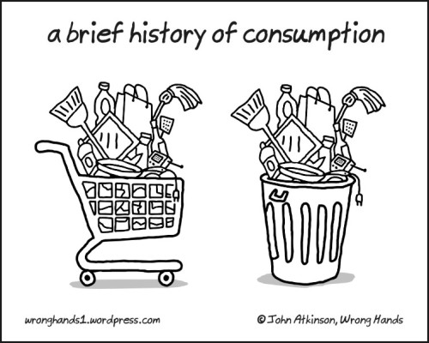
Overconsumption, the root of all evil?

Slide 4
Research estimates 50 ─ 80 % cut in natural resource consumption is necessary

Slide 5
Production & consumption system
www.balticuniv.uu.se/index.php/5a-manufacturing--sustainable-production http://vi.sualize.us/view/eco_oficina/36c1e40bfc65e6972412e7863f9464e1/
Notes:
Environmental policy focus has been in the capping of the impacts from extraction, production and waste generation. There are CO2 quotas, emission limits, etc.
The weak point is the consumption side. The generation of demand created by consumer consumption has been mainly managed with soft policies, environmental education and awareness raising, e.g. environmental labelling. There are some policies, like car taxation, have been targeted directly at consumers, but there is vast potential that is until now unused.
EEA study reductions in environmental impacts of the Pcsystem are mainly due to changes in production systems, not in changes of consumption patterns.
As long as we live in market economy, the demand is created by consumers and if that demand is not harnessed, the system keeps on leaking/running on excess/overconsuming.

Slide 6
The Case of Finland
What kind of alternative policies would the Finnish regime members be ready to accept?

Slide 7
Individual freedom of choice
Western consumer lifestyle
Economic growth
Globalisation and free trade
Planetary boundaries
Population growth
Scarcity of natural resources
Employment
National competitivity
Technology & Innovation
Welfare state
Green growth
Sharing economy
Resource efficiency
Degrowth
Downshifting
Alternative sources
Decentralization
Self-sufficiency
a2ua.com

Slide 8
Mixed method Delphi process
Interviews
Policy evaluation
Differences, tensions, misalignments in
Future images
Policy preferences
Values
Mindsets
Signs of weakening
Legitimacy
Committment
Confidence
Alternative policies in 2040
Assess preferability & acceptability
Comment & discuss at anonymous eDelphi platform
Future Consciousness survey
Differences amongst regime representatives
Impact on their policy choices?

Slide 9
Limit impacts from Housing Mobility Food Consu-mables
Aim: Reduce attraction of harmful products
Aim: Promote low-consumption
Aim: Capping total consumption
Limit or ban advertisements
Targeted taxation
Material footprint measures
City planning measures to promote sharing
Consumption tax
Local bonus trading system
Consumption quotas / allowances
Caps to earnings / worktime

Slide 10
Five Dimensions of Future Consciousness
XX
YY
ZZ
Critical thinking
ÄÄ
BB
CC
Identification with all humanity
ÅÅ
ÖÖ
AA
Considerations of future consequences
Concern for others
Systems Perception
Openness to Change
Agency Beliefs
Time Perspective

Slide 11
In conclusion
Reporting results from two perspectives
Study of transition potential – interview data
Study of policy acceptability – eDelphi data

Slide 12
Thank you!
Sanna Ahvenharju
Finland Futures Research Centre
Turku School of Economics
FI – 20014 University of Turku
FINLAND
sanna.ahvenharju@utu.fi
http://users.utu.fi/sajoahv
Research funded by

Slide 13
REGIME ACTOR MATRIX – FINNISH CONSUMPTION SOCIETY PEOPLE IN A POSITION OF INFLUENCE / OPINION LEADERS / POWER PLAYERS
Field of experience or interest
Sector of influence | policy / politics |  |  |  |  | SPC
Parliament |  | economic |  |  |  |  | housing
Local government |  |  | environmental |  |  |  |  |  | food
Ministries |  |  |  | socio- cultural |  |  |  |  |  | transport
Interest groups |  |  |  |  | ethical |  |  |  |  |  |  | consumables
Companies
Science/ Research Institutes
Media, art, culture

Slide 14
Strong policies to harness demand?
Stop to the ’Individualisation of responsibility’
From ABC approach to systemic changes
Right to free choice vs. right to sustainable ways of living?
Continuum to ’welfare state’ type of policies?
Notes:
Targetting consumption reduction has been considered politically incorrect and against the consumer’s freedom of choice. Thus the policies have been based on the faith on consumers capabilities to ”make the right choices”.
Elisabeth Shove: the current policies build on attitude, behaviour and choice of individuals rather than look at how the systems in which we live in and which either enable or disable certain types of living, are build and how they could be developed to support sustainable lifestyles

Slide 15
Decision-makers as change agents of transition?
Landscape
* Grin, J., Rotmans, J. & Schot, J. (2011) Transitions to Sustainable Development: New Directions in the Study of Long Term Transformative Change. Routledge.
Increasingly complex systems
Regime
Niche
Time
Notes:
TYPICALLY THIS IS DONE BY ÀNALYSING PAST EVENTS – I AM TRYING TO FORESEE A TRANSITION? IS THIS EVEN A RIGHT THEORY FOR ME??

Slide 16
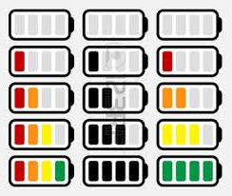
Policy suggestions
Improve product standards
Ban harmful products
Banning advertisements
Targeted tax (as compensation)
General consumption tax
Material footprint targets for households
Sharing systems
Local bonus trading system
Quotas or allowances
Capping wealth

Slide 17
Decision makers’ images of the future
Are our decision makers ready to take more radical action and try new ways, since old ones are not enough?
Notes:
Decision makers as change agents of transition – searching for rifts in the regime

Slide 18
TABLE WITH ALL POLICIES

